Slide 1
Project Planning Excel Timeline
Monday 12
September |  |  |  |  |  |  |  |  |  |  |  |  |  |  |  |  | Q2
Text Here | September |  |  |  | February |  |  |  |  | March |  |  |  |  | April |  |  |  |  |  | May |  |  |  | June |  |  |  |  | July
 | 2 | 13 | 16 | 23 | 46 | 4 | 13 | 20 | 17 | 34 | 5 | 23 | 44 | 34 | 3 | 10 |  | 17 | 24 |  | 1 | 5 | 22 | 29 | 5 | 12 | 17 | 24 |  | 3 | 10 | 15 | 24 | 31 | 7
Project Week |  |  |  |  |  |  |  | 1 | 2 | 3 | 4 | 5 | 6 | 7 | 8 | 9 |  | 10 | 11 | 12 | 13 | 14 | 15 | 16 | 17 | 18 | 19 | 20 | 21 | 22 | 23 | 24 | 25 | 26
2 weeks
*Bacterial isolation check *Acclimatation for 10 days *Grow bacteria
Phase One |  |  |  |  |  |  |  |  |  |  |  |  |  |  |  |  |  |  |  |  |  |  |  |  |  |  |  |  |  |  |  |  |  | P
Project Definition and Planning |  |  |  |  |  |  |  |  |  |  |  |  |  |  |  |  |  |  |  |  |  |  |  |  |  |  |  |  |  |  |  |  |  | R
 |  |  |  |  |  |  |  |  |  |  |  |  |  |  |  |  |  |  |  |  |  |  |  |  |  |  |  |  |  |  |  |  |  | O
 |  |  |  |  |  |  |  |  |  |  |  |  |  |  |  |  |  |  |  |  |  |  |  |  |  |  |  |  |  |  |  |  |  | J
 |  |  |  |  |  |  |  |  |  |  |  |  |  |  |  |  |  |  |  |  |  |  |  |  |  |  |  |  |  |  |  |  |  | E
 |  |  |  |  |  |  |  |  |  |  |  |  |  |  |  |  |  |  |  |  |  |  |  |  |  |  |  |  |  |  |  |  |  | C
Challenge |  |  |  |  |  |  |  |  |  |  |  |  |  |  |  |  |  |  |  |  |  |  |  |  |  |  |  |  |  |  |  |  |  | T
Project Launch of Execution
 |  |  |  |  |  |  |  |  |  |  |  |  |  |  |  |  |  |  |  |  |  |  |  |  |  |  |  |  |  |  |  |  |  | E
 |  |  |  |  |  |  |  |  |  |  |  |  |  |  |  |  |  |  |  |  |  |  |  |  |  |  |  |  |  |  |  |  |  | N
 |  |  |  |  |  |  |  |  |  |  |  |  |  |  |  |  |  |  |  |  |  |  |  |  |  |  |  |  |  |  |  |  |  | D
Acclimatation (500 fish)
Main Review
Initiation
Scope and Goal Setting
Budget
Work Bkdwn Structure
Text Here
Text Here
Text Here
Text Here
Text Here
Text Here
Text Here
This slide is 100% editable. Adapt it to your needs and capture your audience's attention.

Slide 2
Project Planning Excel Timeline
Today
September |  |  |  |  |  |  |  |  |  |  |  |  |  |  |  |  | Q2
Text Here | January |  |  |  | February |  |  |  |  | March |  |  |  |  | April |  |  |  |  |  | May |  |  |  | June |  |  |  |  | July
 | 1 | 1 | 16 | 23 | 46 | 4 | 13 | 20 | 17 | 34 | 5 | 23 | 44 | 34 | 3 | 10 |  | 17 | 24 |  | 1 | 5 | 22 | 29 | 5 | 12 | 17 | 24 |  | 3 | 10 | 15 | 24 | 31 | 7
Project Week |  |  |  |  |  |  |  | 1 | 2 | 3 | 4 | 5 | 6 | 7 | 8 | 9 |  | 10 | 11 | 12 | 13 | 14 | 15 | 16 | 17 | 18 | 19 | 20 | 21 | 22 | 23 | 24 | 25 | 26
Bacterial
Project Conception and Initiation
Phase One |  |  |  |  |  |  |  |  |  |  |  |  |  |  |  |  |  |  |  |  |  |  |  |  |  |  |  |  |  |  |  |  |  | P
Sampling |  |  |  |  |  |  |  |  |  |  |  |  |  |  |  |  |  |  |  |  |  |  |  |  |  |  |  |  |  |  |  |  |  | R
 |  |  |  |  |  |  |  |  |  |  |  |  |  |  |  |  |  |  |  |  |  |  |  |  |  |  |  |  |  |  |  |  |  | O
 |  |  |  |  |  |  |  |  |  |  |  |  |  |  |  |  |  |  |  |  |  |  |  |  |  |  |  |  |  |  |  |  |  | J
 |  |  |  |  |  |  |  |  |  |  |  |  |  |  |  |  |  |  |  |  |  |  |  |  |  |  |  |  |  |  |  |  |  | E
 |  |  |  |  |  |  |  |  |  |  |  |  |  |  |  |  |  |  |  |  |  |  |  |  |  |  |  |  |  |  |  |  |  | C
Phase One |  |  |  |  |  |  |  |  |  |  |  |  |  |  |  |  |  |  |  |  |  |  |  |  |  |  |  |  |  |  |  |  |  | T
Project Launch of Execution
 |  |  |  |  |  |  |  |  |  |  |  |  |  |  |  |  |  |  |  |  |  |  |  |  |  |  |  |  |  |  |  |  |  | E
 |  |  |  |  |  |  |  |  |  |  |  |  |  |  |  |  |  |  |  |  |  |  |  |  |  |  |  |  |  |  |  |  |  | N
 |  |  |  |  |  |  |  |  |  |  |  |  |  |  |  |  |  |  |  |  |  |  |  |  |  |  |  |  |  |  |  |  |  | D
Project Charter
Main Review
Initiation
Scope and Goal Setting
Budget
Work Bkdwn Structure
Text Here
Text Here
Text Here
Text Here
Text Here
Text Here
Text Here
This slide is 100% editable. Adapt it to your needs and capture your audience's attention.

Slide 3
Project Planning Excel Timeline
Today
September |  |  |  |  |  |  |  |  |  |  |  |  |  |  |  |  | Q2
Text Here | January |  |  |  | February |  |  |  |  | March |  |  |  |  | April |  |  |  |  |  | May |  |  |  | June |  |  |  |  | July
 | 1 | 1 | 16 | 23 | 46 | 4 | 13 | 20 | 17 | 34 | 5 | 23 | 44 | 34 | 3 | 10 |  | 17 | 24 |  | 1 | 5 | 22 | 29 | 5 | 12 | 17 | 24 |  | 3 | 10 | 15 | 24 | 31 | 7
Project Week |  |  |  |  |  |  |  | 1 | 2 | 3 | 4 | 5 | 6 | 7 | 8 | 9 |  | 10 | 11 | 12 | 13 | 14 | 15 | 16 | 17 | 18 | 19 | 20 | 21 | 22 | 23 | 24 | 25 | 26
Bacterial
Project Conception and Initiation
Phase One |  |  |  |  |  |  |  |  |  |  |  |  |  |  |  |  |  |  |  |  |  |  |  |  |  |  |  |  |  |  |  |  |  | P
Sampling |  |  |  |  |  |  |  |  |  |  |  |  |  |  |  |  |  |  |  |  |  |  |  |  |  |  |  |  |  |  |  |  |  | R
 |  |  |  |  |  |  |  |  |  |  |  |  |  |  |  |  |  |  |  |  |  |  |  |  |  |  |  |  |  |  |  |  |  | O
 |  |  |  |  |  |  |  |  |  |  |  |  |  |  |  |  |  |  |  |  |  |  |  |  |  |  |  |  |  |  |  |  |  | J
 |  |  |  |  |  |  |  |  |  |  |  |  |  |  |  |  |  |  |  |  |  |  |  |  |  |  |  |  |  |  |  |  |  | E
 |  |  |  |  |  |  |  |  |  |  |  |  |  |  |  |  |  |  |  |  |  |  |  |  |  |  |  |  |  |  |  |  |  | C
Phase One |  |  |  |  |  |  |  |  |  |  |  |  |  |  |  |  |  |  |  |  |  |  |  |  |  |  |  |  |  |  |  |  |  | T
Project Launch of Execution
 |  |  |  |  |  |  |  |  |  |  |  |  |  |  |  |  |  |  |  |  |  |  |  |  |  |  |  |  |  |  |  |  |  | E
 |  |  |  |  |  |  |  |  |  |  |  |  |  |  |  |  |  |  |  |  |  |  |  |  |  |  |  |  |  |  |  |  |  | N
 |  |  |  |  |  |  |  |  |  |  |  |  |  |  |  |  |  |  |  |  |  |  |  |  |  |  |  |  |  |  |  |  |  | D
Project Charter
Main Review
Initiation
Scope and Goal Setting
Budget
Work Bkdwn Structure
Text Here
Text Here
Text Here
Text Here
Text Here
Text Here
Text Here
This slide is 100% editable. Adapt it to your needs and capture your audience's attention.

Slide 4
Instructions To Edit This Slide
This slide has been made in PowerPoint using basic PowerPoint shapes, and all graphics are 100% editable in PowerPoint.
You can change color, size and orientation of any element to your liking, and add/edit any piece of text anywhere.

Slide 5
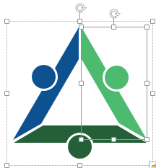
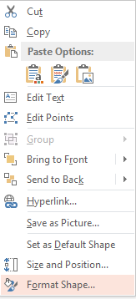
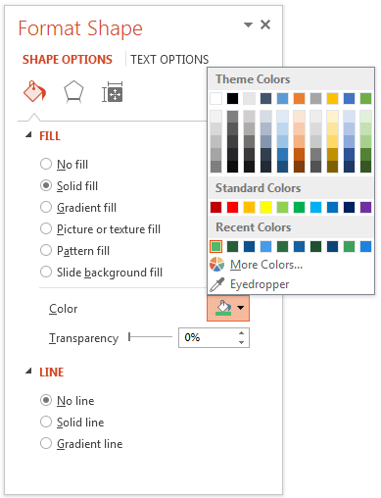
Resize Any Shape And Edit Color
The entire slide has been made in PowerPoint itself, and you can edit the color of any component in this graphic. To change the color, just right click the object to highlight it, and then follow instructions.
1
2
3
Right click on the object or shape that you want to change the color of.
Choose Format Shape in the dialog box.
Choose “Fill” in the Format Shape box then “Solid” or “Gradient” depending on the appearance of the object. Change colour as shown in the picture.

Slide 6
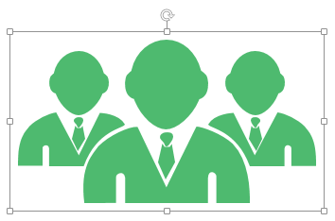
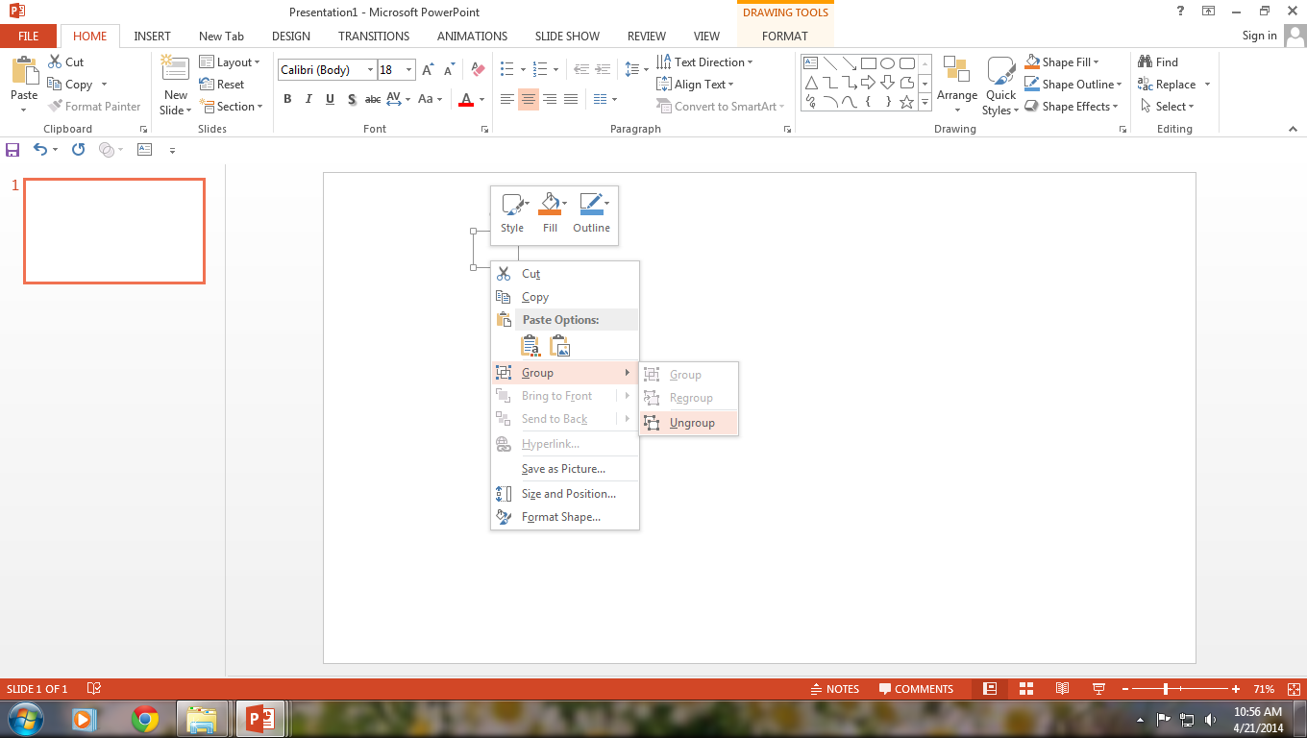
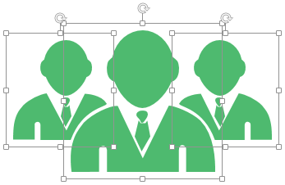
Use Your Own Icons In Any Slide
You can replace the icons in this slide with any icons you like from our site, or completely remove them if required.
1
2
3
The icons we have shown are just for demo purposes. You can replace these icons with the correct icons to suit your message. We have a large collection of icons to choose from.
To replace any icon, double click on it and select it, and then right click it to ungroup it.
Delete the icon and replace it with any icon or graphic from our site.

Slide 7
Select From Thousands Of Editable Icons On Every Topic
These icons are available at the Icons section on www.slideteam.net

Slide 8




Project Planning Timeline
August |  |  | September |  |  |  |  |  |  |  |  |  |  |  |  |  |  |  |  |  |  |  |  |  |  |  |  |  |  |  |  |  | Oct
Dates | 2021
 | 30 | 31 | 1 | 2 | 3 | 4 | 5 | 6 | 7 | 8 | 9 | 10 | 11 | 12 | 13 | 14 | 15 | 16 | 17 | 18 | 19 | 20 | 21 | 22 | 23 | 24 | 25 | 26 | 27 | 28 | 29 | 30 | 1 | 2
Project Day | M | T | W | T | F | S | S | M | T | W | T | F | S | S | M | T | W | T | F | S | S | M | T | W | T | F | S | S | M | T | W | T | F | S
Project Week |  |  |  |  |  |  |  |  |  |  |  |  |  |  | 1 |  |  |  |  |  |  | 2 |  |  |  |  |  |  | 3
Phase one
Project Conception Definition Planning Initiation
Phase Two
Pond/fish Bacterial recovery Bacterial preparation Fish swabs Immunization
Phase Three
Challenge tests Lab assays ELISA & PCR Bacteriology Draw results Conclusions
Main Review
Scope and Goal Setting
Work Bkdwn Structure
Initiation
Prepare ponds and acclimate 7 days
Recover the two bacterial strains 1 day
Culture bacteria
Produce vaccine
Immunization 1
Fish swabs 1
Fish swabs 2
Bacterial isolation on 5 fish. Date: TBD

Slide 9

Project Planning Timeline
September |  |  | October |  |  |  |  |  |  |  |  |  |  |  |  |  |  |  |  |  |  |  |  |  |  |  |  |  |  |  |  |  | Nov
Dates | 2021
 | 29 | 30 | 1 | 2 | 3 | 4 | 5 | 6 | 7 | 8 | 9 | 10 | 11 | 12 | 13 | 14 | 15 | 16 | 17 | 18 | 19 | 20 | 21 | 22 | 23 | 24 | 25 | 26 | 27 | 28 | 29 | 30 | 31 | 1
Project Day | W | T | F | S | S | M | T | W | T | F | S | S | M | T | W | T | F | S | S | M | T | W | T | F | S | S | M | T | W | T | F | S | S | M
Project Week | 29 | 30 | 1 | 2 |  |  |  |  |  |  |  |  |  |  | 1 |  |  |  |  |  |  | 2 |  |  |  |  |  |  | 3
Phase one
Project Conception Definition Planning Initiation
Phase Two
Pond/fish Bacterial recovery Bacterial preparation Fish swabs Immunization
Phase Three
Challenge tests Lab assays ELISA & PCR Bacteriology Draw results Conclusions
Immunization 2 Booster of day 21
Fish swabs 3
Fish swabs 4
Fish swabs 5
Fish swabs 6
F
First bacterial challenge

Slide 10
Project Planning Timeline
October |  |  | November |  |  |  |  |  |  |  |  |  |  |  |  |  |  |  |  |  |  |  |  |  |  |  |  |  |  |  |  |  | Dec
Dates | 2021
 | 30 | 31 | 1 | 2 | 3 | 4 | 5 | 6 | 7 | 8 | 9 | 10 | 11 | 12 | 13 | 14 | 15 | 16 | 17 | 18 | 19 | 20 | 21 | 22 | 23 | 24 | 25 | 26 | 27 | 28 | 29 | 30 | 1 | 2
Project Day | S | S | M | T | W | T | F | S | S | M | T | W | T | F | S | S | M | T | W | T | F | S | S | M | T | W | T | F | S | S | M | T | W | T
Project Week |  |  |  |  |  |  |  |  |  |  |  |  |  |  | 1 |  |  |  |  |  |  | 2 |  |  |  |  |  |  | 3
Phase one
Project Conception Definition Planning Initiation
Phase Two
Pond/fish Bacterial recovery Bacterial preparation Fish swabs Immunization
Phase Three
Challenge tests Lab assays ELISA & PCR Bacteriology Draw results Conclusions
Fish swabs 7
Fish swabs 8
Fish swabs 9
Fish swabs 10
Fish swabs 11

Slide 11


Project Planning Timeline
November |  |  | December |  |  |  |  |  |  |  |  |  |  |  |  |  |  |  |  |  |  |  |  |  |  |  |  |  |  |  |  |  | Jan
Dates |  |  |  |  |  |  |  |  |  |  |  |  |  |  |  |  |  |  |  |  |  |  |  |  |  |  |  |  |  |  |  |  | 2022
 | 29 | 30 | 1 | 2 | 3 | 4 | 5 | 6 | 7 | 8 | 9 | 10 | 11 | 12 | 13 | 14 | 15 | 16 | 17 | 18 | 19 | 20 | 21 | 22 | 23 | 24 | 25 | 26 | 27 | 28 | C | 30 | 31 | 1
Project Day | M | T | W | T | F | S | S | M | T | F | S | S | M | T | W | T | F | S | S | M | T | W | T | F | S | S | M | T | W | T | F | S | S | M
Project Week |  |  |  |  |  |  |  |  |  |  |  |  |  |  | 1 |  |  |  |  |  |  | 2 |  |  |  |  |  |  | 3
Phase one
Project Conception Definition Planning Initiation
Phase Two
Pond/fish Bacterial recovery Bacterial preparation Fish swabs Immunization
Phase Three
Challenge tests Lab assays ELISA & PCR Bacteriology Draw results Conclusions
Fish swabs 11
Fish swabs 12
First bacterial challenge
Lab assays to monitor immune response
ELISA
PCR
Agglutination
Draw results
Conclude

